Slide 1
Use Case Diagram

Slide 2
Use Case Diagram
A use case in software engineering and systems engineering is a description of a system’s behavior
In other words, a use case describes "who" can do "what" with the system in question.
The use case technique is used to capture a system's behavioral requirements by detailing scenario-driven threads through the functional requirements.

Slide 3
Use Case Diagram objects
Use case diagrams consist of 4 objects.
Actor
Use case
System
Package
The objects are further explained below.

Slide 4
Use Case Diagram objects
Actor
An actor represents a set of roles that users of use case play when interacting with these use cases.
Actors can be human or automated systems.
Actors are entities which require help from the system to perform their task or are needed to execute the system’s functions
name

Slide 5
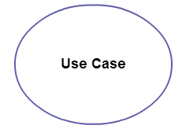
Use Case Diagram objects
Use Case
A use case represents a function or an action within the system. It’s drawn as an oval and named with the function.

Slide 6
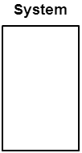
Use Case Diagram objects
System
The system is used to define the scope of the use case and drawn as a rectangle. This an optional element but useful when you’re visualizing large systems. For example, you can create all the use cases and then use the system object to define the scope covered by your project. Or you can even use it to show the different areas covered in different releases.

Slide 7
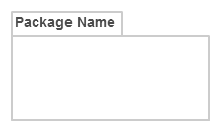
Use Case Diagram objects
Package
The package is another optional element that is extremely useful in complex diagrams. Similar to class diagrams, packages are used to group together use cases. They are drawn like the image shown below.

Slide 8
Relationships in Use Case Diagrams
There are five types of relationships in a use case diagram. They are
Association between an actor and a use case
Generalization of an actor
Extend relationship between two use cases
Include relationship between two use cases
Generalization of a use case

Slide 9
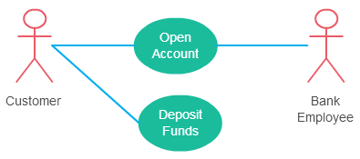
Relationships in Use Case Diagrams
1. Association Between Actor and Use Case
This one is straightforward and present in every use case diagram. Few things to note.
An actor must be associated with at least one use case.
An actor can be associated with multiple use cases.
Multiple actors can be associated with a single use case.

Slide 10
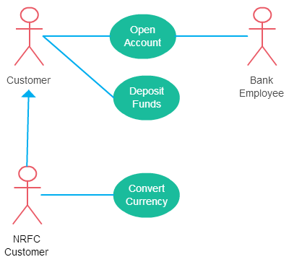
Relationships in Use Case Diagrams
2. Generalization of an Actor
Generalization of an actor means that one actor can inherit the role of the other actor. The descendant inherits all the use cases of the ancestor. The descendant has one or more use cases that are specific to that role. Let’s expand the previous use case diagram to show the generalization of an actor.

Slide 11
Relationships in Use Case Diagrams
Extend Relationship Between Two Use Cases
Many people confuse the extend relationship in use cases. As the name implies it extends the base use case and adds more functionality to the system. Here are few things to consider when using the <<extend>> relationship.
The extending use case is dependent on the extended (base) use case. In the below diagram the “Calculate Bonus” use case doesn’t make much sense without the “Deposit Funds” use case.
The extending use case is usually optional and can be triggered conditionally. In the diagram, you can see that the extending use case is triggered only for deposits over 10,000 or when the age is over 55.
The extended (base) use case must be meaningful on its own. This means it should be independent and must not rely on the behavior of the extending use case.
Lets expand our current example to show the <<extend>> relationship.

Slide 12
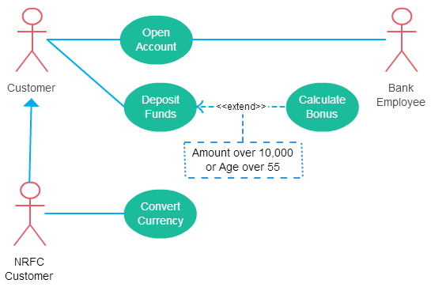
Relationships in Use Case Diagrams
Although extending use case is optional most of the time it is not a must. An extending use case can have non-optional behavior as well. This mostly happens when your modeling complex behaviors.
For example, in an accounting system, one use case might be “Add Account Ledger Entry”. This might have extending use cases “Add Tax Ledger Entry” and “Add Payment Ledger Entry”. These are not optional but depend on the account ledger entry. Also, they have their own specific behavior to be modeled as a separate use case.

Slide 13
Relationships in Use Case Diagrams
Include Relationship Between Two Use Cases
Include relationship show that the behavior of the included use case is part of the including (base) use case. The main reason for this is to reuse the common actions across multiple use cases. In some situations, this is done to simplify complex behaviors. Few things to consider when using the <<include>> relationship.
The base use case is incomplete without the included use case.
The included use case is mandatory and not optional.
Let expand our banking system use case diagram to show include relationships as well.

Slide 14
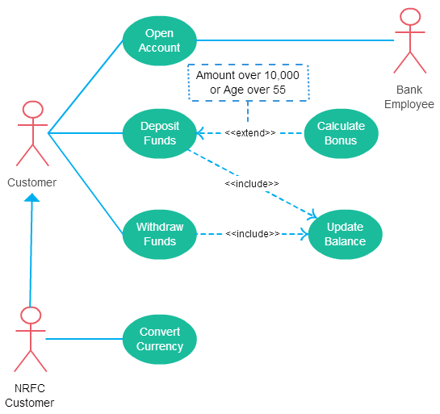
Relationships in Use Case Diagrams

Slide 15
Relationships in Use Case Diagrams
Generalization of a Use Case
This is similar to the generalization of an actor. The behavior of the ancestor is inherited by the descendant. This is used when there is common behavior between two use cases and also specialized behavior specific to each use case.
For example, in the previous banking example, there might be a use case called “Pay Bills”. This can be generalized to “Pay by Credit Card”, “Pay by Bank Balance” etc.

Slide 16
registration
updating
grades
student
faculty
output
generating

Slide 17
URS
add member
system
user
del member
add subject
academic
del subject
assg subject
unassg subject
enrol subject
student
unenrol subject

Slide 18
Use Case Diagram – Example1 (Library)
library system
borrow
client
employee
reserve
Order title
Fine payment
supervisor
A Library System.

Slide 19
Use Case Diagram for Student Assessment Management System
Grade system
Record grades
Student
View grades
Teacher
Distribute
Report cards
Create report cards
Printing administrator

Slide 20
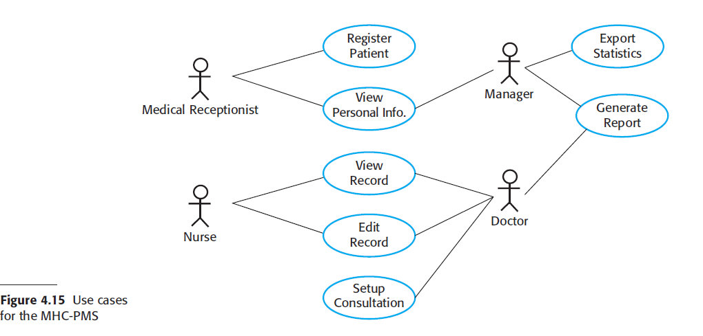

Slide 21
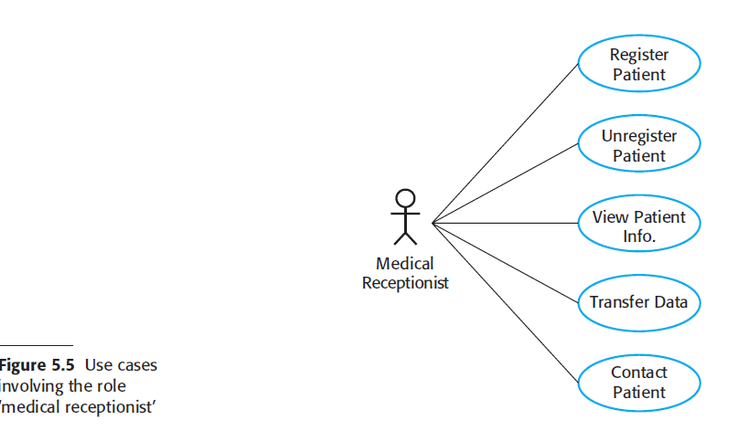

Slide 22
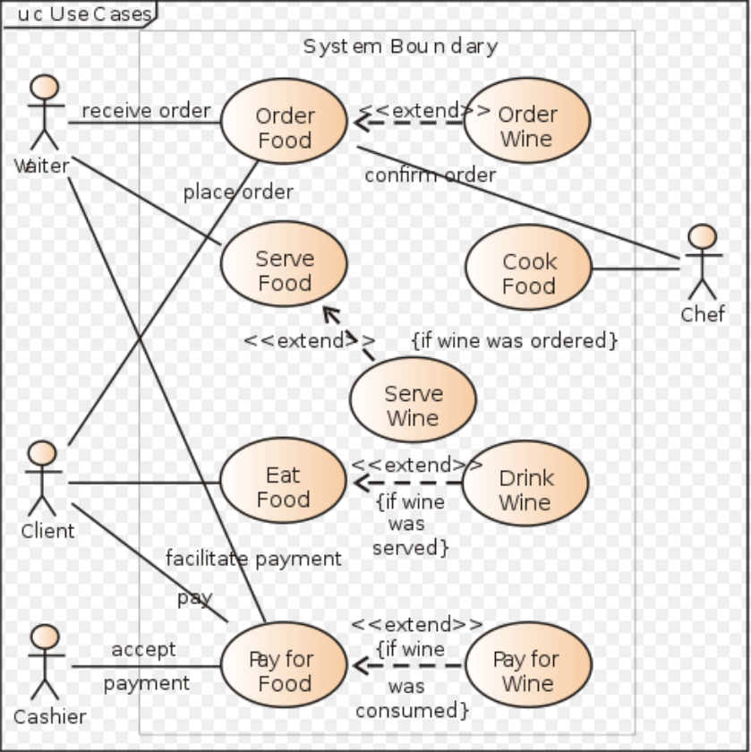

Slide 23
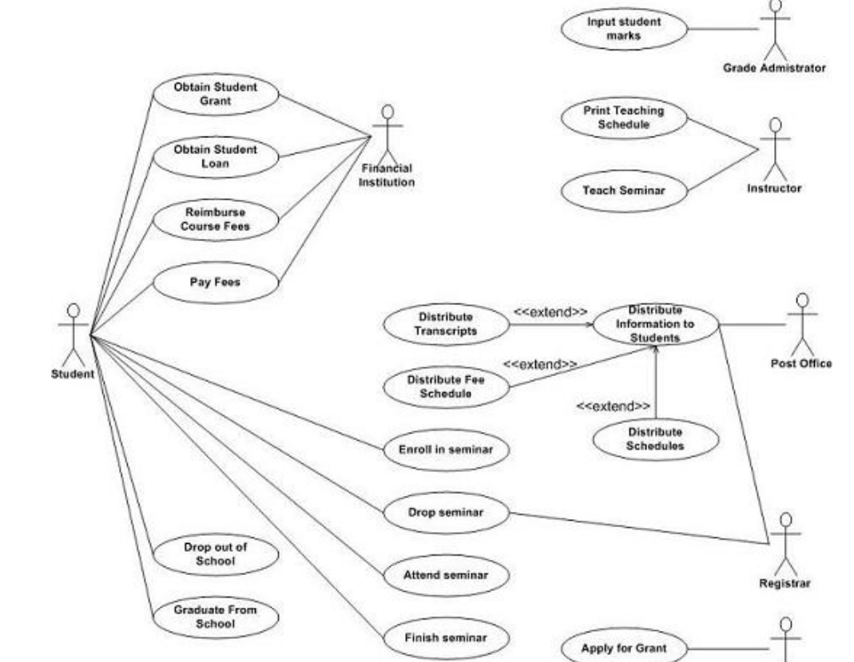
School Management

Slide 24
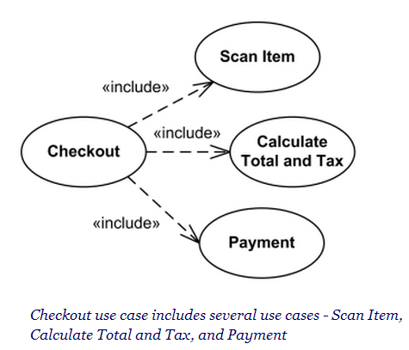

Slide 25
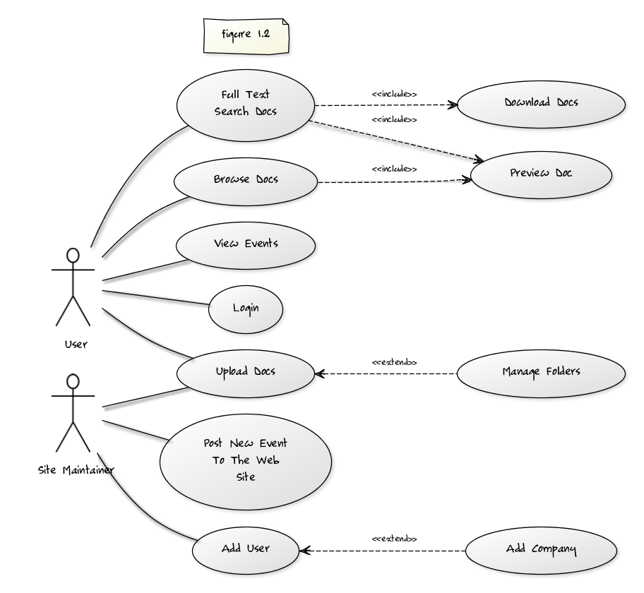

Slide 26
